Slide 2
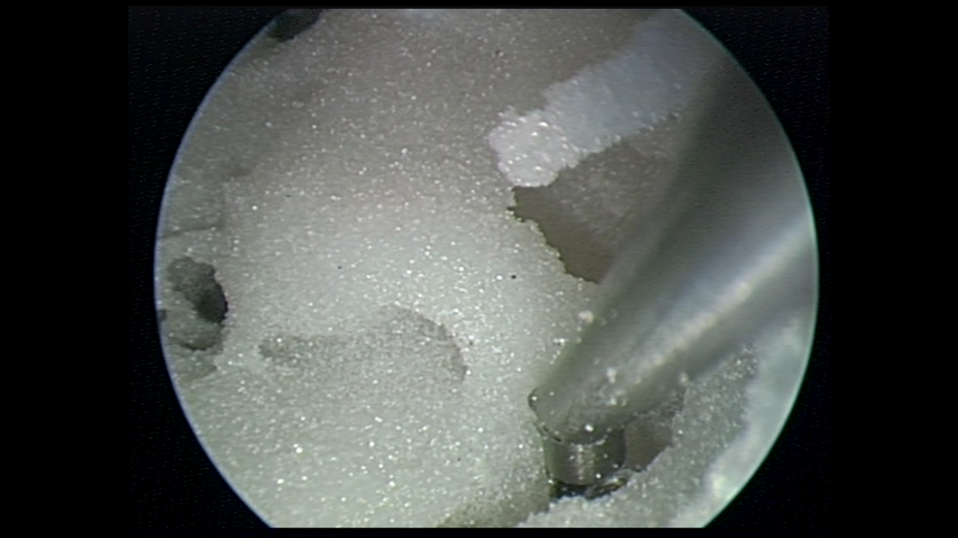
Promontory
Sinus Tympani

Slide 3
